Slide 1

Martial Arts Gym Information and Tracking System (MAGITS)

Slide 2


Introduction
TeamBits
Members:
Aldrin John Jacildo
Sir Angel Naguit
Francis Victa
Maria Lillian Yang
Notes:
Script:

Slide 3
Project Description
Web application that automates a business process of Martial Arts Gyms
It also solves common problems that the business face in their everyday operations
The project will:
Enable the gym to keep digital records of accounts and profiles
Monitor and manage membership types of students
Track their attendance and use modern QR code technologies to submit attendance

Slide 4
Project Vision

Slide 5
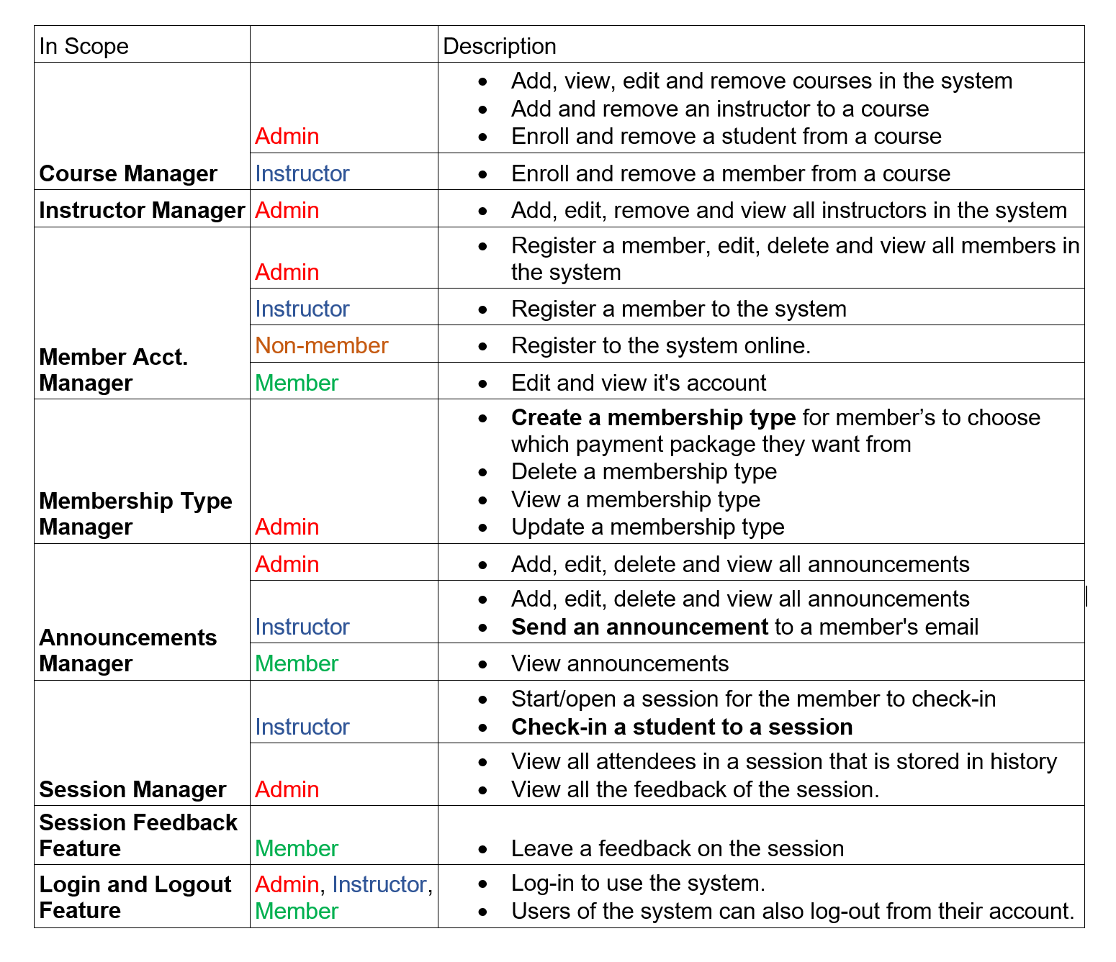
Project Vision - In Scope

Slide 6
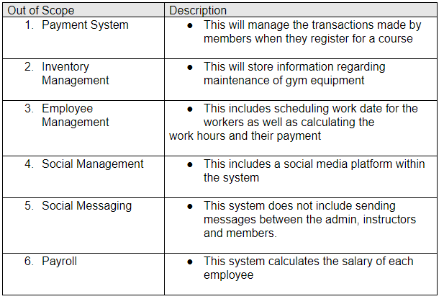
Project Vision - Out of Scope

Slide 7
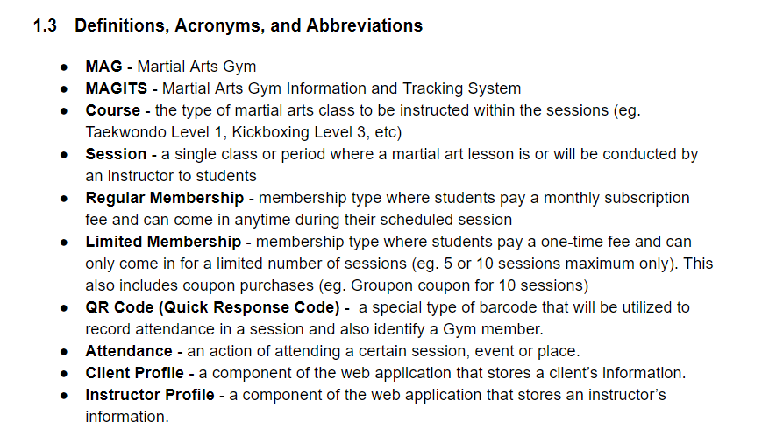
Project Vision - Definitions

Slide 8
Project Vision - Problem Statement
Problem:
Manual information tracking
Physical data storage
No communication platform
Affected:
Gym owners
Instructors
Students
Impact:
Inconsistent records
Potential loss of important information
Students being unaware of gym announcements such as class cancellations
Loss of potential revenue

Slide 9
Project Vision - Problem Statement
A successful solution - A system that:
Records profile information on instructors, students, sessions
Tracks sessions and attendance of students and instructors
Allow announcements from instructor to students
Store information digitally in the cloud

Slide 10
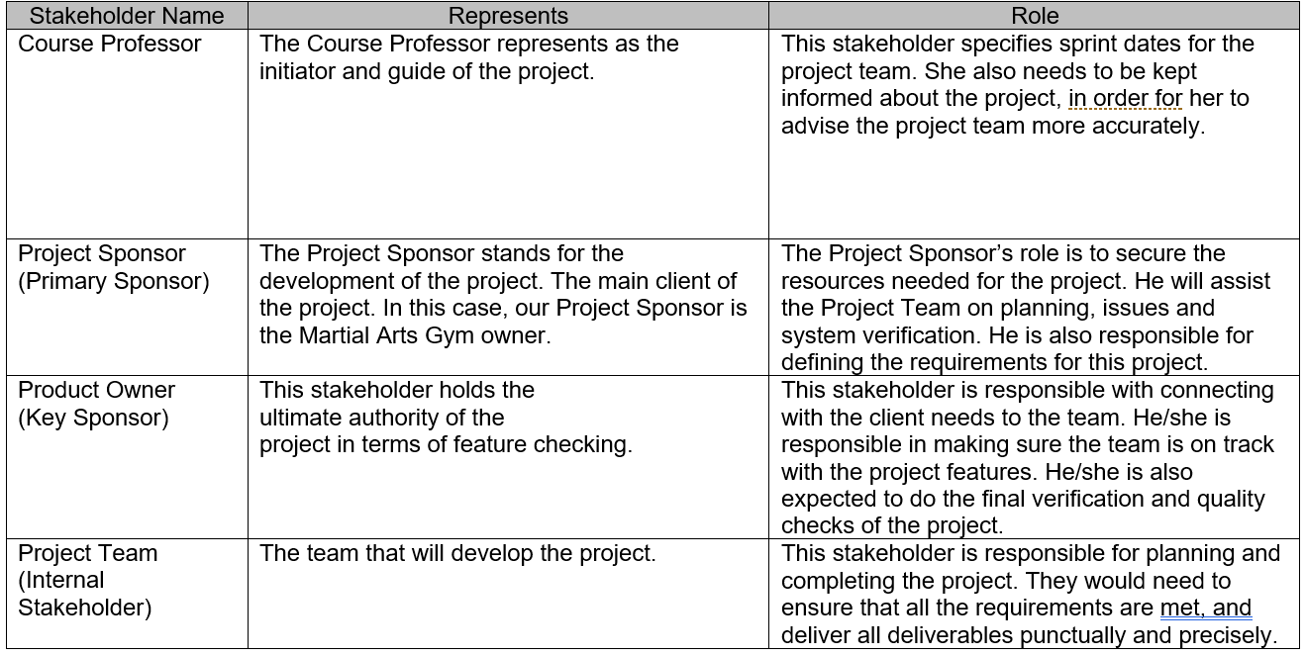
Project Vision - Stakeholder Summary

Slide 11
Project Vision - Stakeholder Requirements
In a requirement or feature statement
“Must” means the requirement is mandatory.
“Should” means the requirement is optional.
In an ID cell for the stakeholder requirement table,
“RA” means that it is a requirement for Administrator
“RI” means that it is a requirement for Instructor
“RM” means that it is a requirement for a Member

Slide 12
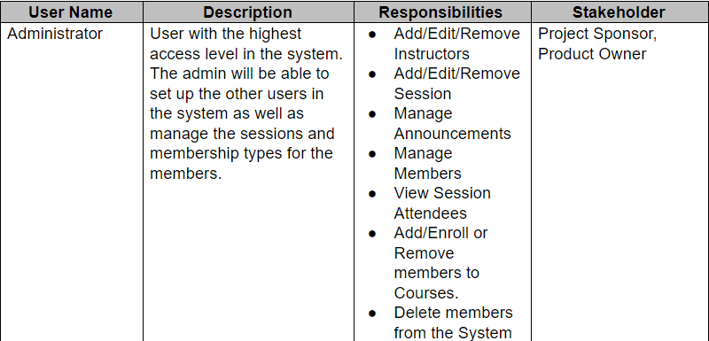
Project Vision: User Summary - Admin

Slide 13
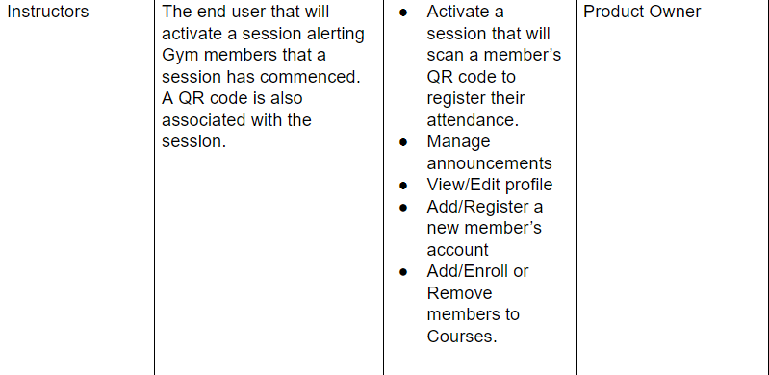
Project Vision: User Summary - Instructor

Slide 14
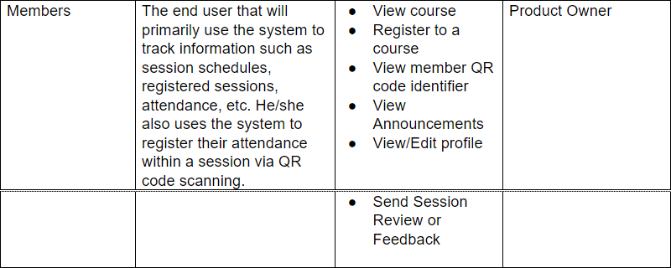
Project Vision: User Summary - Member

Slide 15
High Level Requirements

Slide 16
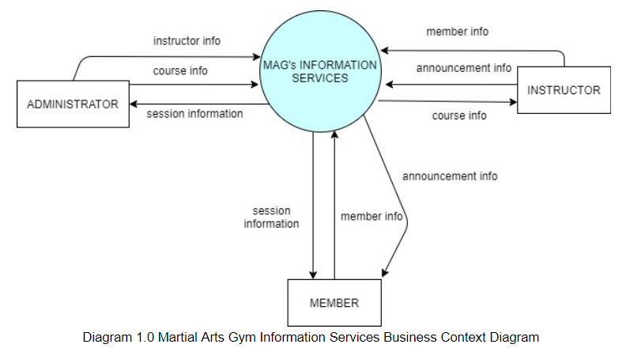
High Level Requirements:
Business Context Diagram

Slide 17
Project Plan

Slide 18
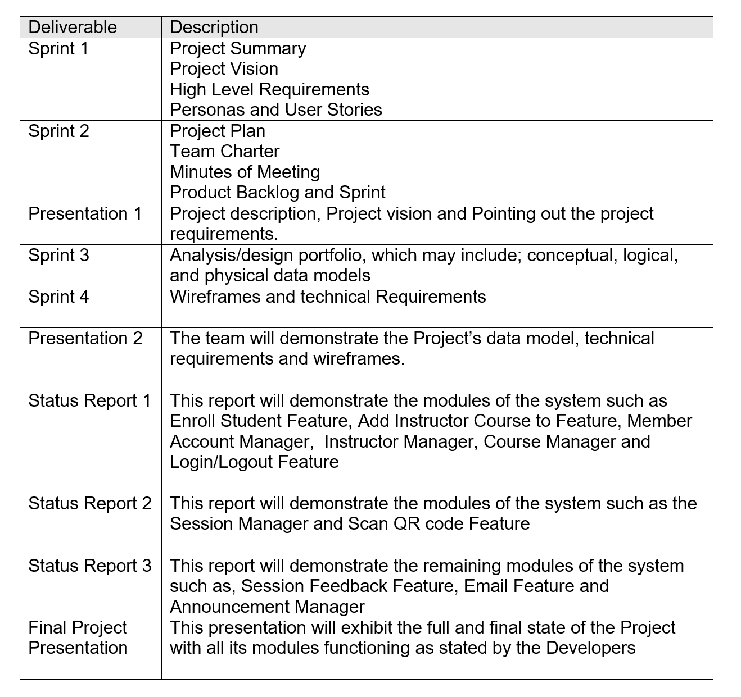
Project Plan -
Deliverables

Slide 19
Project Plan - Assumptions
The system is for small businesses, which is defined as privately owned corporations, partnerships, or sole proprietorships that have fewer employees and/or less annual revenue than a regular-sized business or corporation.
Every session will have less than 50 members participating at any given day.
The MAG staff are computer literate.
The gym member always carries a device or a card that has their QR code for the session check-in.

Slide 20
Project Plan - Dependencies
Internal Dependencies
The user must be registered to be able to see the courses in the system.
The member should pay the membership before they are enrolled in a course by the instructor.
The user must be enrolled in a course to be able to have a qr code where their course session will be scanned and thus having their attendance tracked.
The admin or the instructor must be logged in to be able to use the qr scanner.
External Dependency
The system will be utilizing a cloud based database thus it must be up at all times.

Slide 21
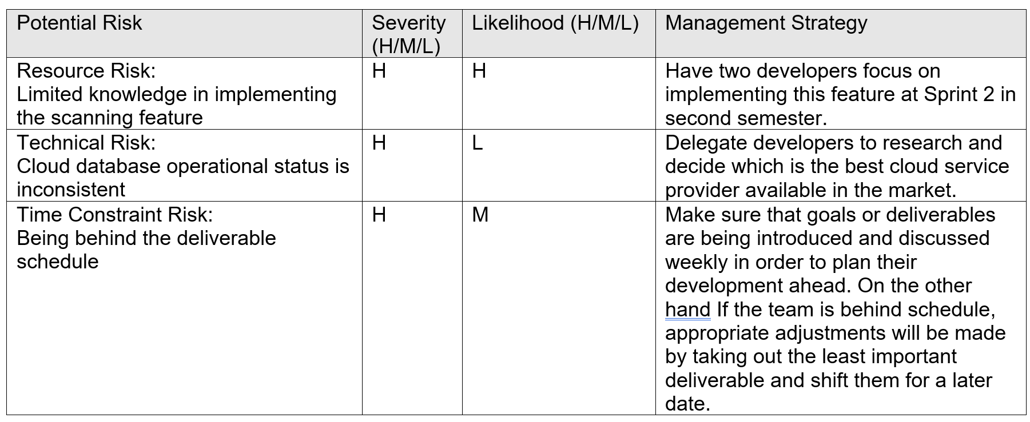
Project Plan - Risk Management

Slide 22
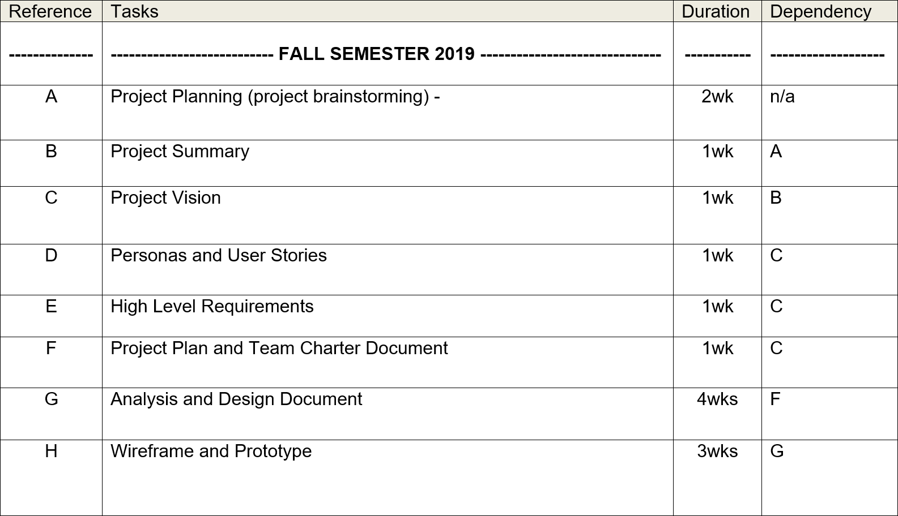
Project Plan - Task Listing(WBS)

Slide 23
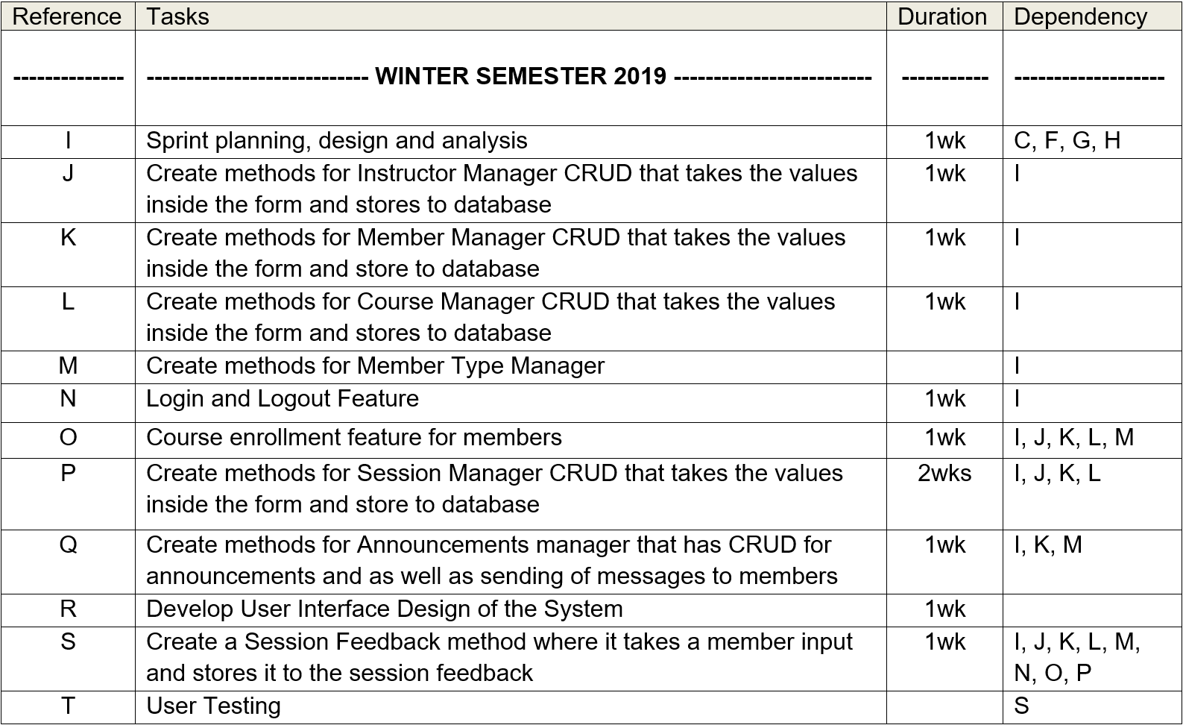
Project Plan - Task Listing(WBS) contd.

Slide 24
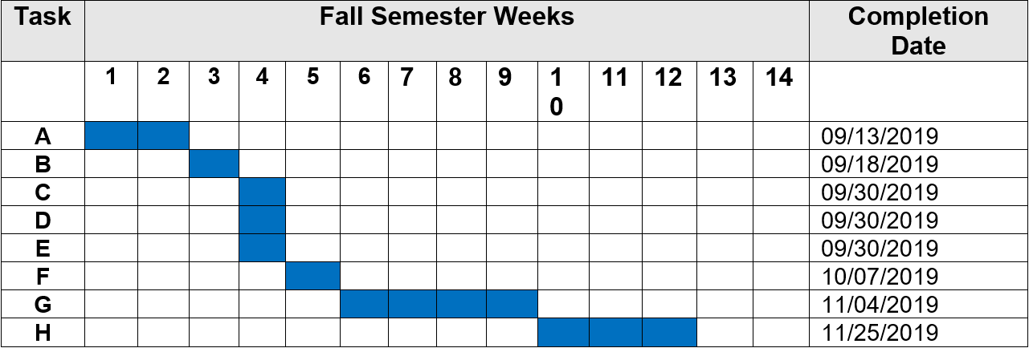
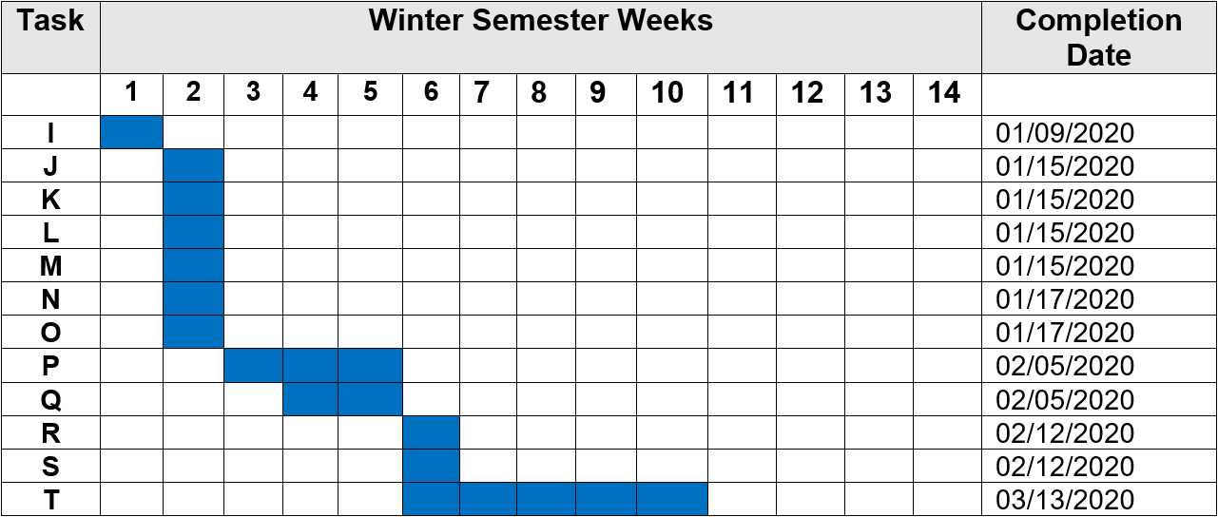
Project Plan - Gantt Chart

Slide 25
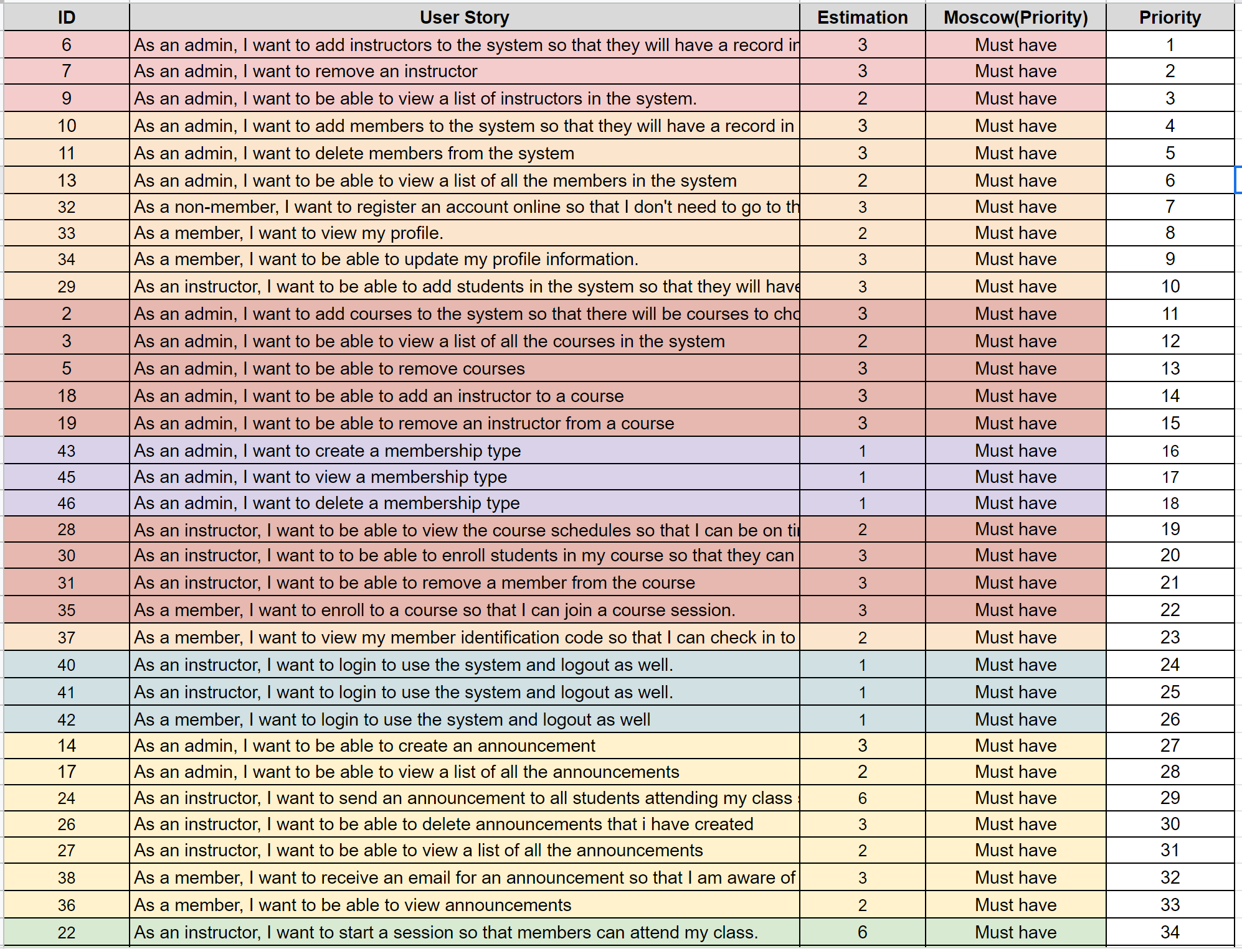
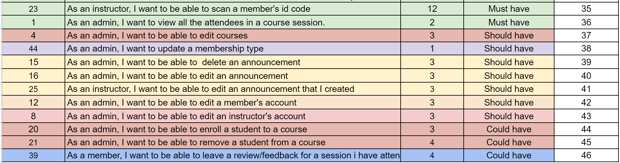
Product
Backlog

Slide 26
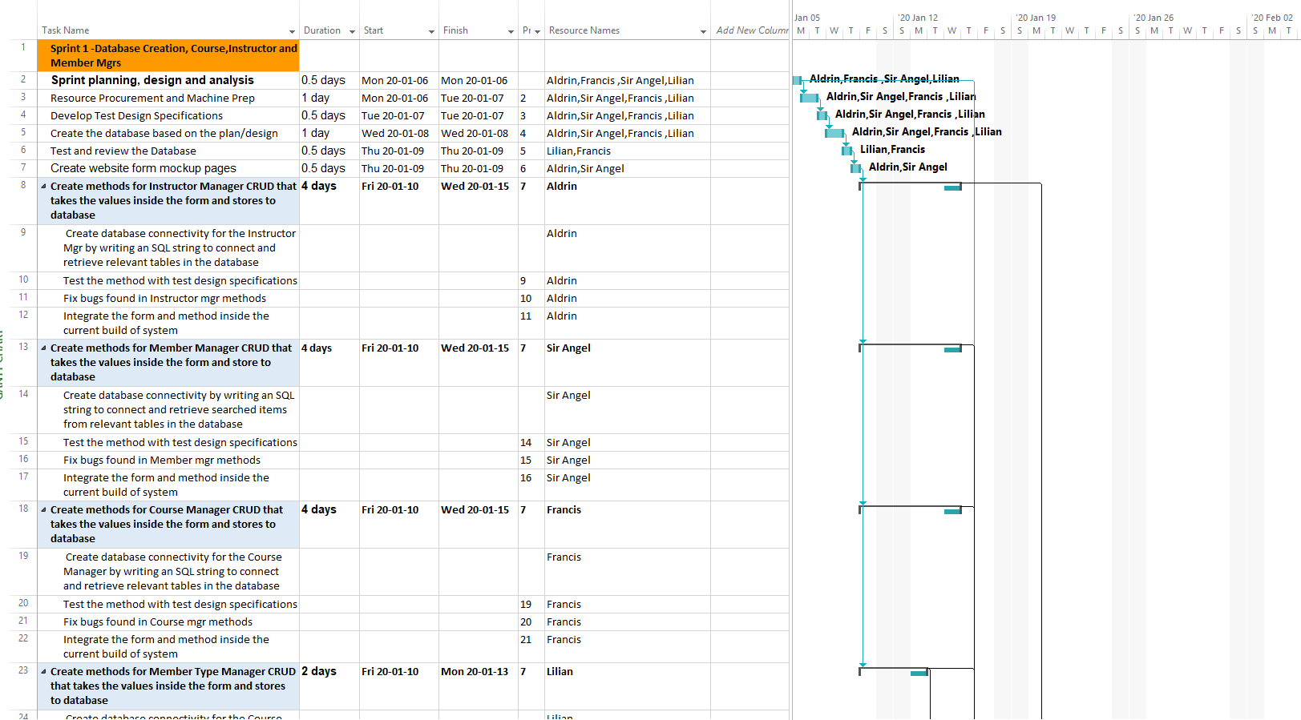
Sprint Backlog
Implementation Phase

Slide 27
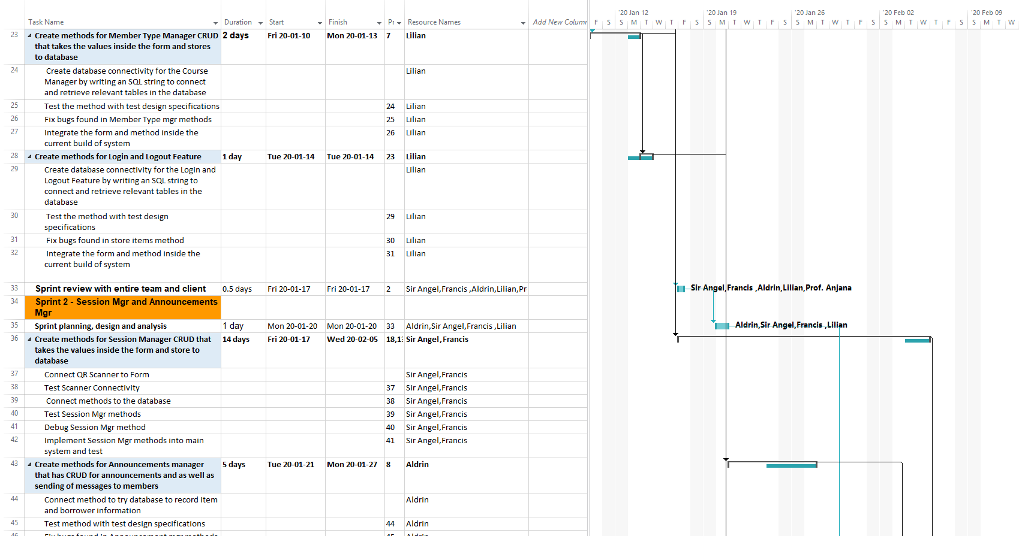
Sprint Backlog page 2

Slide 28
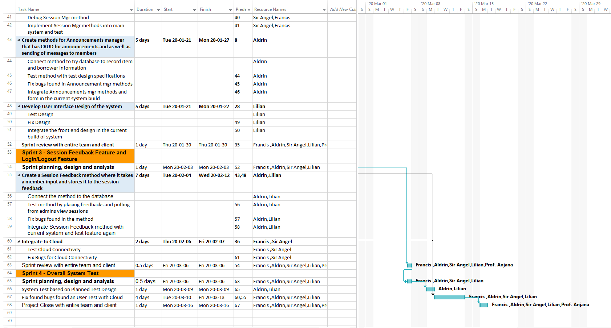
Sprint Backlog page 3

Slide 29
Team Charter

Slide 30
Team Charter - Purpose
The team ‘Team Bits’ has been formed to complete the Capstone Assignment as part of the Course T127 (Computer Programming Analyst). The objectives of the team are to complete and learn each material related to the Project and to demonstrate that knowledge through the final presentation. We will also be working as a team to effectively finish tasks and goals within given deadlines. This will be achieved by openly listening to everyone's ideas, committing to plans and helping each members when they need it.
Notes:
-satisfy
-involve
-point

Slide 31
Team Charter - Background
The team comprises of different educational backgrounds
25% of the team has knowledge in the industry
100% of the team have programming skills
Team have similar cultural background
Notes:
-work together very well

Slide 32
Team Charter - High Level Goals
To create a working prototype by the end of the first sprint
To implement new features at the end of every sprint period after the first
To implement QR scanning technology into the system
To integrate the system with cloud services
Notes:
github

Slide 33
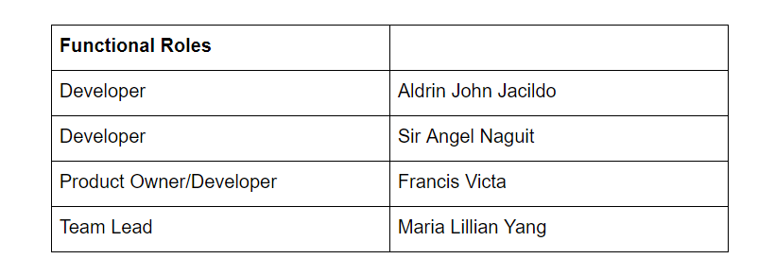
Team Charter - Team Composition

Slide 34
Team Charter - Team Empowerment
Team Authority:
The team already possess full authority required to perform the objectives. Although additional authority might be required from the Instructor to allow for big changes or additions to the system.

Slide 35
Team Charter - Team Operations
Team Meetings:
The purpose of team meetings is to set an agenda for the team to follow in order to meet the requirements by the given deadline.
Decision Making Process:
The team makes sure that every decision being applied in the Project is well reviewed and discussed before being added in the revision. This ensures the transparency and synergy of the ideas in the Project.
Team Communication:
The team uses two means of communication, primarily through face-to-face meetings and secondarily, through online audio conference.

Slide 36
Team Charter - Assessment
The team will conduct an evaluation at every conclusion of a meeting. In this evaluation we will:
Evaluate the team’s effectiveness in regards with the task currently at hand.
Evaluate inconclusive tasks and try to look for solutions and/or answers for the next meeting.
Evaluate feasibility of upcoming tasks until the next meeting.
Evaluate the team’s synergy.

Slide 37

End of Presentation! :)

